Slide 1
NEARBY
GROUNDWATER
CONTAMINATION

Slide 2
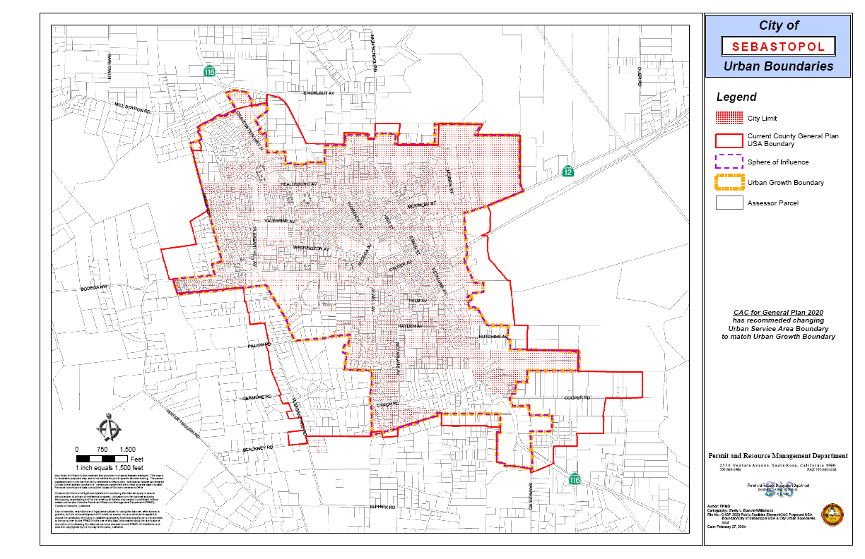

Slide 3
HOMAN TIRES
Shallow well 100-200 ppb PCE
MTbE; hydrocarbons; solvents
REDWOOD MARKET (Superior)
Shallow wells – no PCE
No deep wells
FIESTA CENTER (LaBlue)
Shallow well in back – 8,000 ppb PCE
600 ft well – no results

Slide 4
tank
7.5 HP
Pump
generator
sanitary
seal
sanitary
seal
7.5 HP
Pump
PCE
NO
PCE
15 HP
Pump
Well #1 BACKUP
Well #2 MAIN

Slide 5
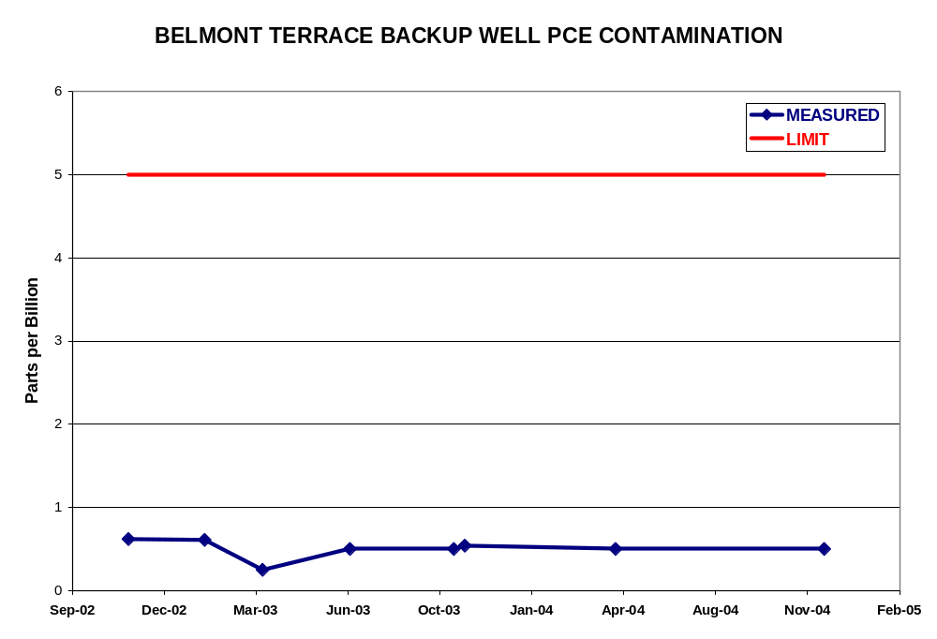
WATER QUALITY
NOT IN
MAIN WELL

Slide 6
UPGRADE NEEDS
(WATER & WASTEWATER)

Slide 7
WATER UPGRADE NEEDS
WHY?
PCE in backup well
Summer nitrate high in backup well
Old equipment is failing
Need larger generator for main well
Unbalanced PG&E power
Reduce electricity costs
50-year piping old system; need replacement plan
Need to document our groundwater as an asset

Slide 8
NEW SEPTIC/LEACH REGULATIONS
were supposed to start Jan 1, 2007; already started in Marin
New design standards
Mandatory monitoring
NEW COSTS
FOR EACH HOME
upgrades
certification
monitoring

Slide 9
UPGRADE
COSTS

Slide 10
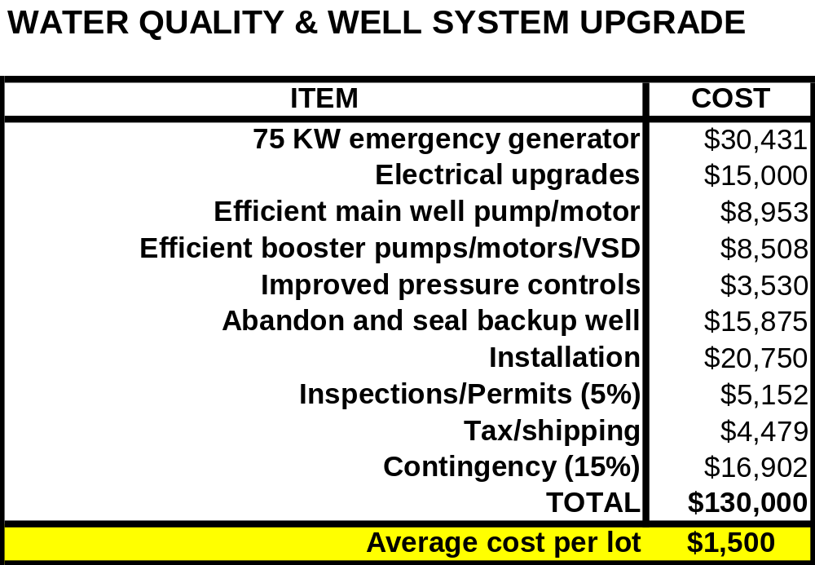
2007
$140,000

Slide 11
RESERVE FOR
WATER MAINS REPLACEMENT
(emergency repair only)
ITEM
COST
Water Distribution (8")
$628,943
Repave streets
$69,219
Curb/Gutter Repair
$46,460
Inspections
$22,339
2007
$900,000
Contingency 15%
$115,044
TOTAL
$880,000
Average cost per lot
$10,400

Slide 12
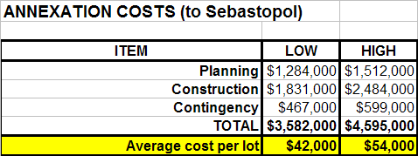
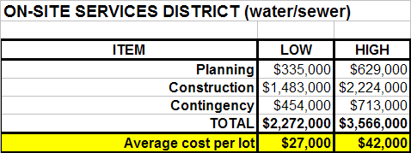
RATES
$150/mo
+ 9%/yr
2007
$80,000
RATES
$150/mo
+ 5%/yr
increase
3%/yr

Slide 13
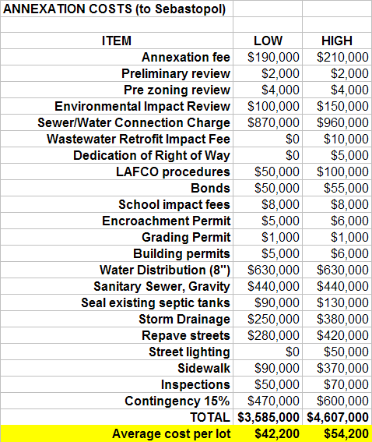
2007
(So.Cal)
$160,000
RATES
$150/month
+ 9%/yr increase

Slide 14
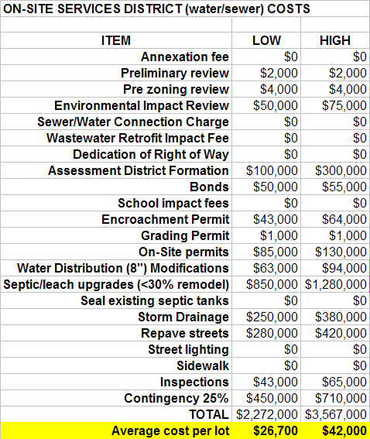
increase
3%/yr
RATES
$200/month
+ 5%/yr increase

Slide 15
2006 COST vs REVENUE

Slide 16
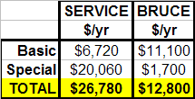
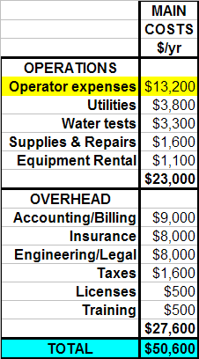
$90/hr
$45/hr
No increase in reserves
ACTUAL COSTS
$52,841
REVENUE
$52,200

